Slide 1
Exploring the Socio-Economic Determinants of Educational Performance: A Study of Thanaweya Amma Exams in Egypt (2022-2023)

Slide 2
TABLE OF CONTENTS
01
02
03
SECTION
Introduction
SECTION
Factors of intrest
SECTION
Members

Slide 3
Introduction
01.

Slide 4

Our Aim
The primary aim of this study is to analyze how socio-economic factors affect Thanaweya Amma result across different governorates in Egypt, this involves examining a variety of indicators including :
Income levels and work hours.
Healthcare facilities.
Work force.
GDP.

Slide 5
Why we intersted in education ?
Education is a the most important aspect any development seeking society should focus on, as it plays a crucial role in shaping the future of individuals and communities. In Egypt, one important metric of education is Thanaweya Amma, the national high school examination. The Thanaweya Amma exams gain their significance from being the key factor in determining the professional future of high-school students.

Slide 6
Factors of intrest
02.

Slide 7
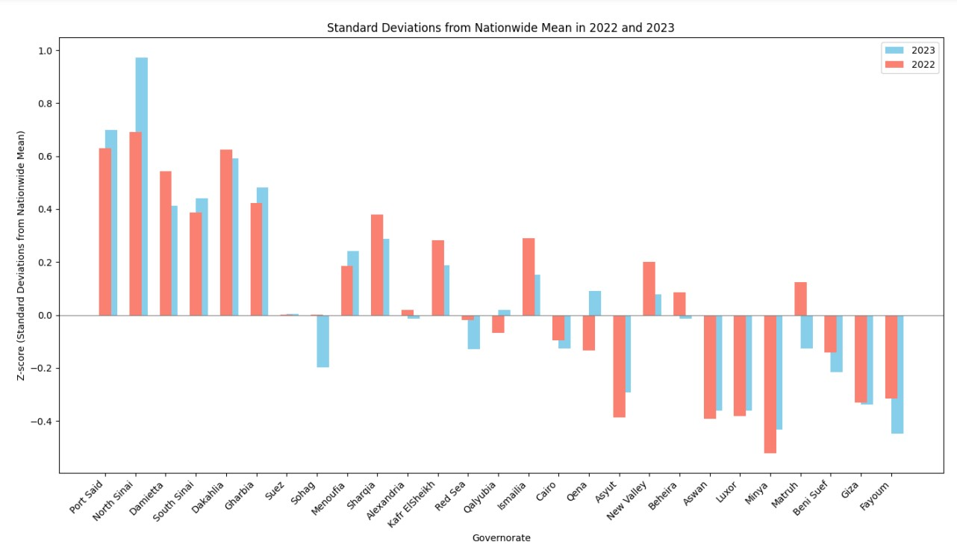
Analyzing the Thanaweya Amma scores :
we analyze the Thanaweya Amma scores for the years 2022 and 2023 to gain insights into the educational performance across governorates in Egypt. Our analysis focuses on understanding the trends and patterns in scores, as well as identifying any changes in performance over the two-year period.

Slide 8
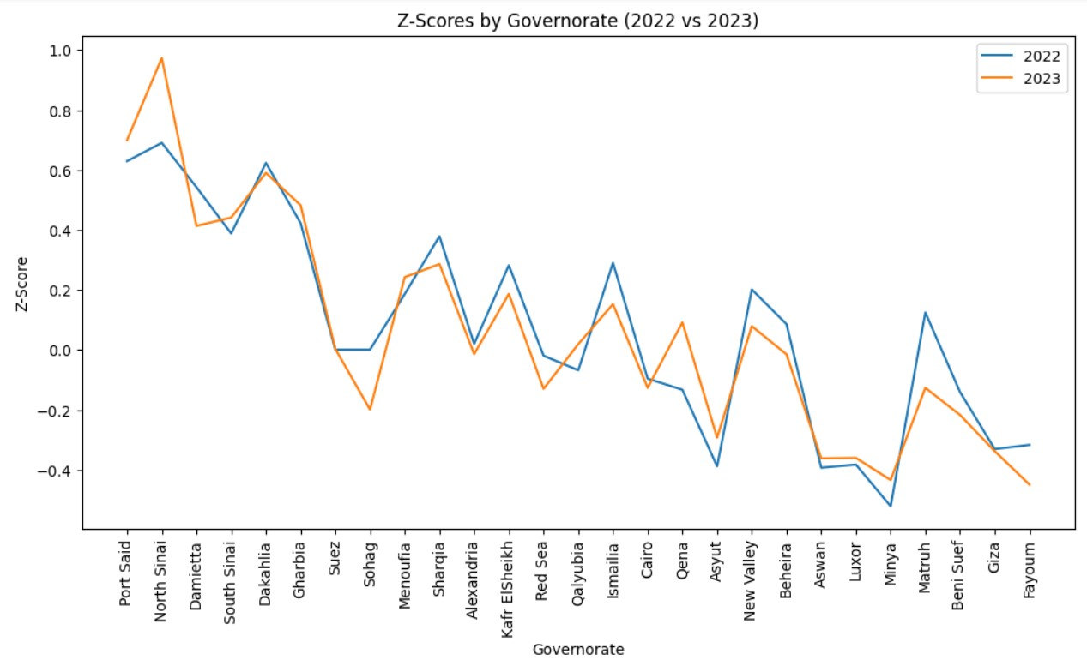
Analyzing the Thanaweya Amma scores :
Data Collection: We collected Thanaweya Amma scores for each governorate for the years 2022 and 2023 to build our dataset.
Mean Calculation: Calculated the mean score for each governorate in both 2022 and 2023 to determine the average performance and identify any changes over time.
Z-Score Calculation: Standardized the scores using z-scores to facilitate comparison across governorates and years, considering the variations in score distributions.
Analysis: Examined the trends and variations in mean scores and z-scores to identify any changes in educational performance over the two-year period.

Slide 9




Socio-economic factors
GDP
Income levels
Relation by GDP of each Governorate
Relation by Average work hours and Average salary
Workforce
Health Facilities
Relation by number of workforce and education level.
Relation by healthcare facilities in each Governorate

Slide 10
GDP
In the GDP analysis, we conducted two main analyses. Firstly, we examined the total GDP of each governorate and its relationship with the educational results of that governorate. Secondly, we divided the GDP into sectors, such as agriculture GDP, and sought to determine the correlation between these economic activities and the educational outcomes in each governorate.

Slide 11
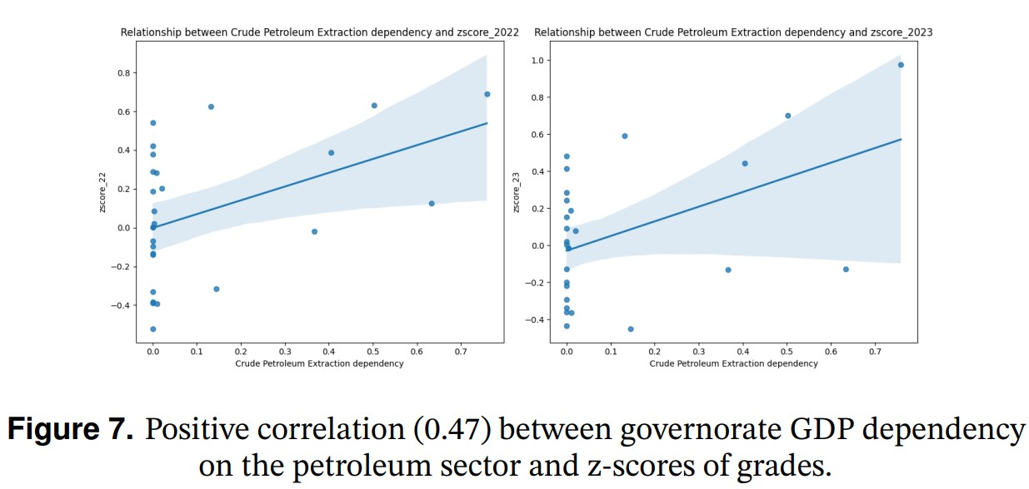
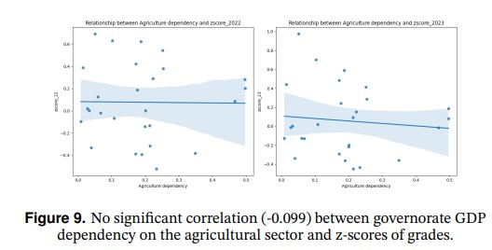
Figure 7:
illustrates the positive correlation (0.47) between the dependency on the petroleum sector and the z-scores of grades. This
indicates that governorates with a higher dependency on petroleum
tend to have higher z-scores, suggesting a potential link between
economic wealth generated from petroleum and better educational
performance.
Figure 9:
highlights the lack of correlation (-0.099) between the dependency on the agricultural sector and the z-scores of grades. This
suggests that the economic dependency on agriculture does not significantly impact the educational performance in governorates.

Slide 12
Workforce
To understand how the education levels of the workforce influenced educational performance, we analyzed the relationship between workforce qualifications and the z-scores of Thanaweya Amma results across different governorates in Egypt. This comprehensive analysis provided insights into how the education levels within the workforce affected academic outcomes.

Slide 13
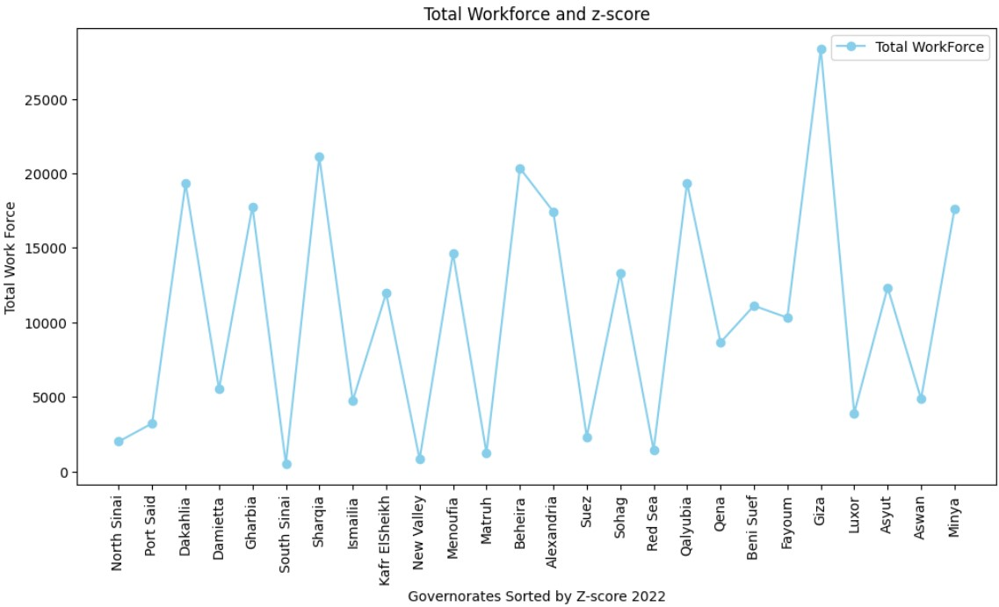
The Figure:
"Total Workforce and z-score“ shows the relationship between workforce qualifications and the z-scores of Thanaweya Amma results across different governorates in Egypt. The governorates are sorted by their z-scores in 2022.
- It’s not apparent that there’s a relationship.

Slide 14
Salaries levels and work hours :
To understand how socio-economic factors influenced educational performance, we analyzed the relationship between average salaries, work hours for both genders, and the z-scores of Thanaweya Amma results across different governorates in Egypt. This comprehensive analysis provided insights into how income levels and work hours for both genders affected academic outcomes

Slide 15
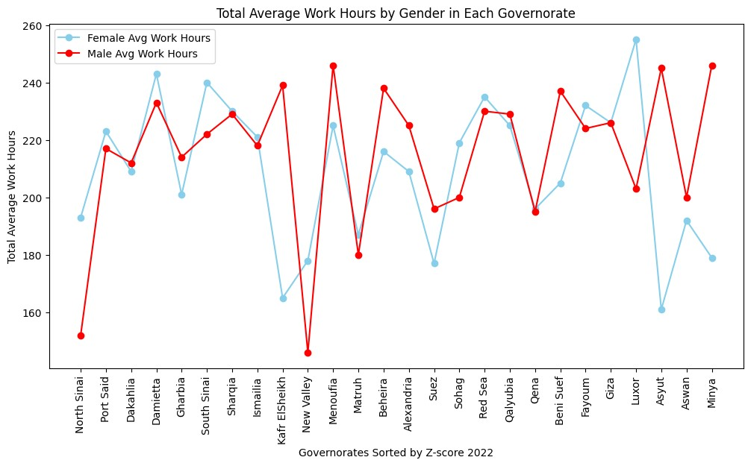
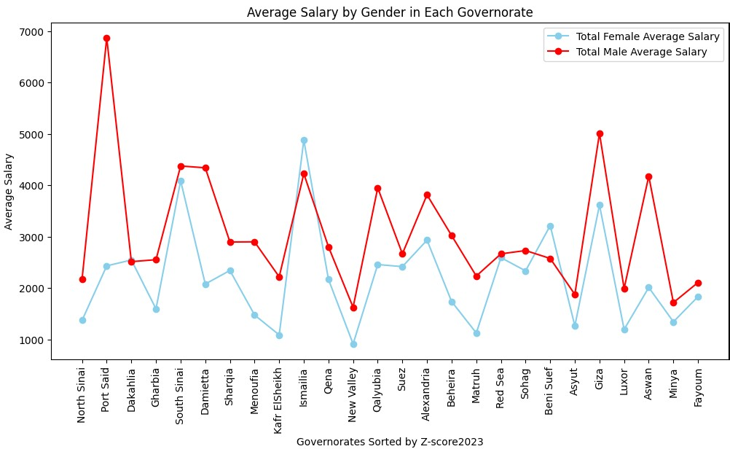
The First figure:
“Total Average Work Hours by Gender in Each Governorate” shows the average work hours for both genders across different governorates in Egypt. The governorates are sorted by their z-scores in Thanaweya Amma results in 2022.
There is no an obvious relation.
The Second figure:
"Average Salary by Gender in Each Governorate" shows the average salary by gender in each governorate of Egypt. The governorates are sorted by their z-scores in Thanaweya Amma results in 2023.
- There is no an obvious relation.

Slide 16
Health Facilities
To understand how the availability of health facilities influenced educational performance, we analyzed the relationship between healthcare infrastructure and the z-scores of Thanaweya Amma results across different governorates in Egypt. This comprehensive analysis provided insights into how the availability of health resources affected academic outcomes.

Slide 17
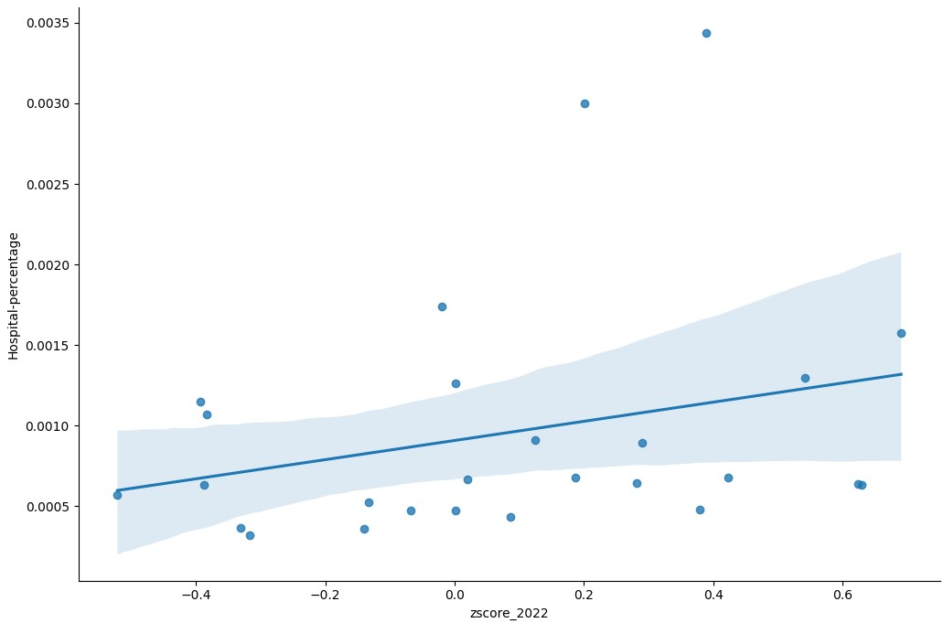
The Figure shows the relationship between two variables using data points. In this scatter plot, the x-axis represents the hospital percentage (presumably a measure of healthcare infrastructure) in each governorate and the y-axis represents the average z-scores of Thanaweya Amma results (presumably a measure of educational performance) in 2022. Each data point represents a governorate.

Slide 18
Members
03.

Slide 19
OUR TEAM
Mohamed Ashraf
22-101206
Mohamoud Ashraf
22-101206
Abdelrahman Sayed
22-101207
Yousief Mohamed
22-101148
Mohamed Sabagh
22-101257

Slide 20
Thanks

